Slide 1



Submitted by : Harish Patchigolla Btech(CSE) 5th semester

Slide 2
Loan Status Prediction Using Exploratory Data Analysis

Slide 3
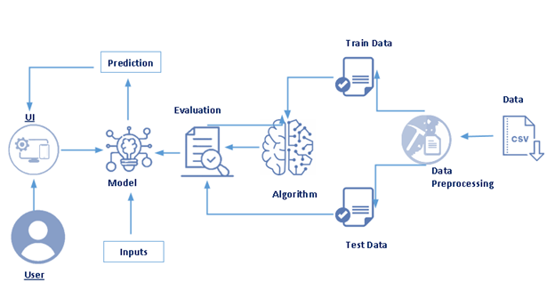
Architecture:

Slide 4
Project Objectives:
1. Knowledge of Machine Learning Algorithms.
2. Knowledge of Python Language with Machine Learning
3. Knowledge of Statistics and Graphs and their relations
4. Real-Time Analysis of Project
5. Building ease of User Interface (UI)
6. Navigation of ideas towards other projects(creativeness)

Slide 5
Project Flow
1. Installing the required packages and libraries.
2. Importing the required libraries for the model to run.
3. Downloading the dataset, feeding it to the model, and understanding the
dataset
4. Data Preprocessing – Checking for outliers and null values. If there any null values we use Label Encoding to convert then into binary format.
5. Dividing the model into Train and Test data. Fitting the model and predicting.
6. Building Flask Web Application.

Slide 6
Importing libraries
Pandas- It is a fast, powerful, flexible, and easy to use open-source data analysis and manipulation tool, built on top of the Python programming language.
Numpy- It is an open-source numerical Python library.
Matplotlib- Visualisation with python
sklearn. Preprocessing- This package provides several common utility functions and transformer classes
Seaborn as sns- Seaborn is a data visualization library in Python based on matplotlib

Slide 7
Data Collection
ML depends heavily on data, without data, it is impossible for a machine to learn. It is the most crucial aspect that makes algorithm training possible. In Machine Learning projects, we need a training data set. It is the actual data set used to train the model for performing various actions.

Slide 8
Download The Dataset
You can collect datasets from different open sources like kaggle.com, data.gov, UCI machine learning repository etc.
The dataset used for this project was obtained from Kaggle. Please refer to the link given below to download the data set and to know about the dataset
Link- https://www.kaggle.com/zaurbegiev/my-dataset

Slide 9
Data Preprocessing
Data pre-processing is a process of cleaning the raw data i.e. the data is collected in the real world and is converted to a clean data set. In other words, whenever the data is gathered from different sources it is collected in a raw format and this data isn’t feasible for the analysis.
Therefore, certain steps are executed to convert the data into a small clean data set, this part of the process is called as data pre-processing Follow the following steps to process your Data
Import the Libraries
Importing the dataset
Taking care of Missing Data
Label encoding
One Hot Encoding
Feature Scaling
Splitting Data into Train and Test

Slide 10
Build Flask Application
Flask Frame Work with Machine Learning Model In this section, we will be building a web application that is integrated into the model we built. A UI is provided for the uses where he has to enter the values for predictions. The enter values are given to the saved model and prediction is showcased on the UI

Slide 11

Run The App
Open anaconda prompt from start menu.
Navigate to the folder where your app.py resides.
Now type “python app.py” command.
It will show the local host where your app is running on http://127.0.0.1.5000/
Copy that localhost URL and open that URL in the browser. It does navigate you to where you can view your web page.
Enter the values, click on the predict button and see the result/prediction on web page.
In the below example, ‘/’ URL is bound with index.html function. Hence, when the home page of web server is opened in browser, the html page will be rendered. Whenever you enter the values from the html page the values can be retrieved using POST Method.

Slide 12
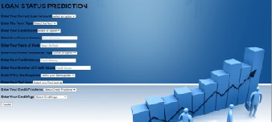
Output
Here we are routing our app to y_predict() function. This function retrieves all the values from the HTML page using Post request. A variable X test is defined to store the entire element in two-dimensional arrays. This two-dimensional array is passed to model.predictfunction (). This function returns the prediction. And this prediction value is rendered to the text that we have mentioned in the nindex.html page earlier
In the previous page after giving all the parameters click on the predict button to get the prediction

Slide 13
Thank you sir

